Slide 1


E-HEALTH CARE APPLICATION
SUBMITTED BY:
C.SIVAKUMAR
192011306
DATE:31/01/23

Slide 2
OBJECTIVE
Testing helps in evaluating and accessing application features so that it promote healthy living and to facilitate prevention non communicable diseases.

Slide 3
ABSTRACT
Apollo Group one of the largest integrated healthcare groups in the region. The e-website of this group is increasing rapidly especially since covid outbreak.
The project helps to get the accurate functionalities of the web application.
As this e-website has huge impact on current world,it is important to test the websites and applications.

Slide 4
PROPOSED SYSTEM
Using Android studio we can develop the application.
Testing of an application can be done using the testing tools such as Appium.
Installing android studio and Appium application
Setting up an emulator in android studio with latest version
Getting C code for chrome application in android studio
Apollo 24/7
User ID
Location
Search medicines
Health care support
Health product
Add to cart
Address and mobile number
Delivery

Slide 5
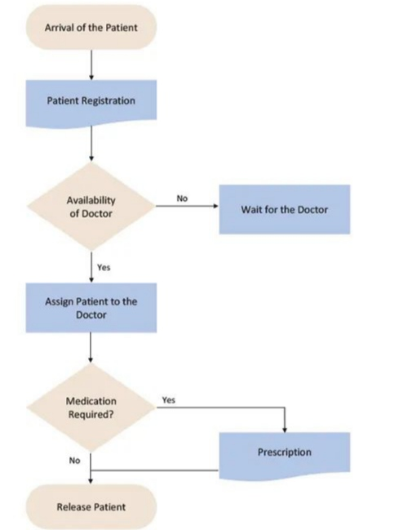
Flow chart

Slide 6
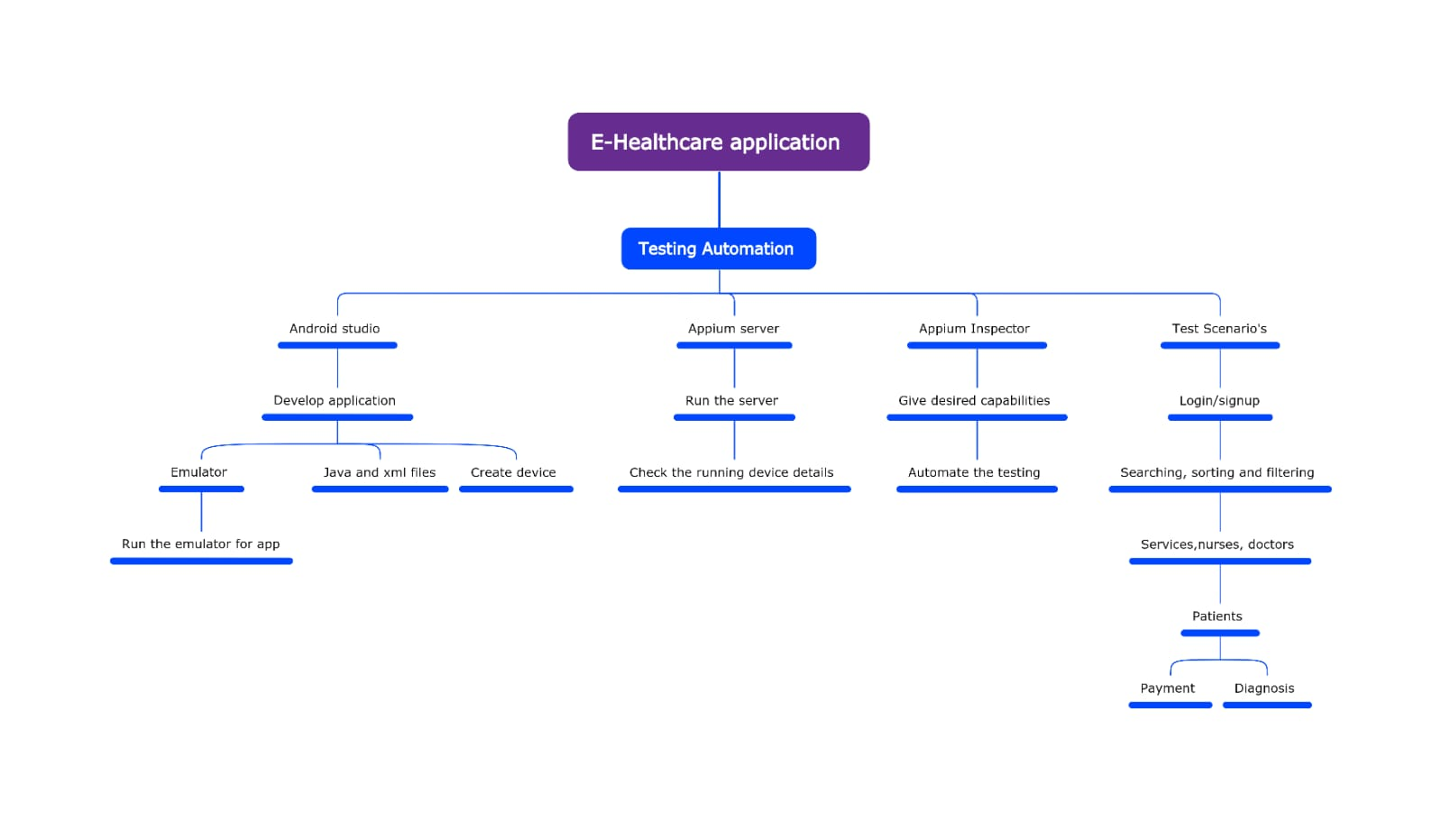
CONCEPT MAPPING

Slide 7
TESTCASES
LOGIN/SIGNUP
SEARCHING
SORTING
FILTERING
PRODUCT DISCRIPTION
DOCTOR CONSULTATION
SHOPPING CART
CHECKOUT
PAYMENT GATEWAY
ORDER CONFIRMATION

Slide 8




Appium Server
Android Studio
Appium Inspector

Slide 9
Android studio
Appium inspector
Download Android Studio
Install SDK in Android Studio
Download Emulator in Android Studio
Download Appium Inspector

Slide 10
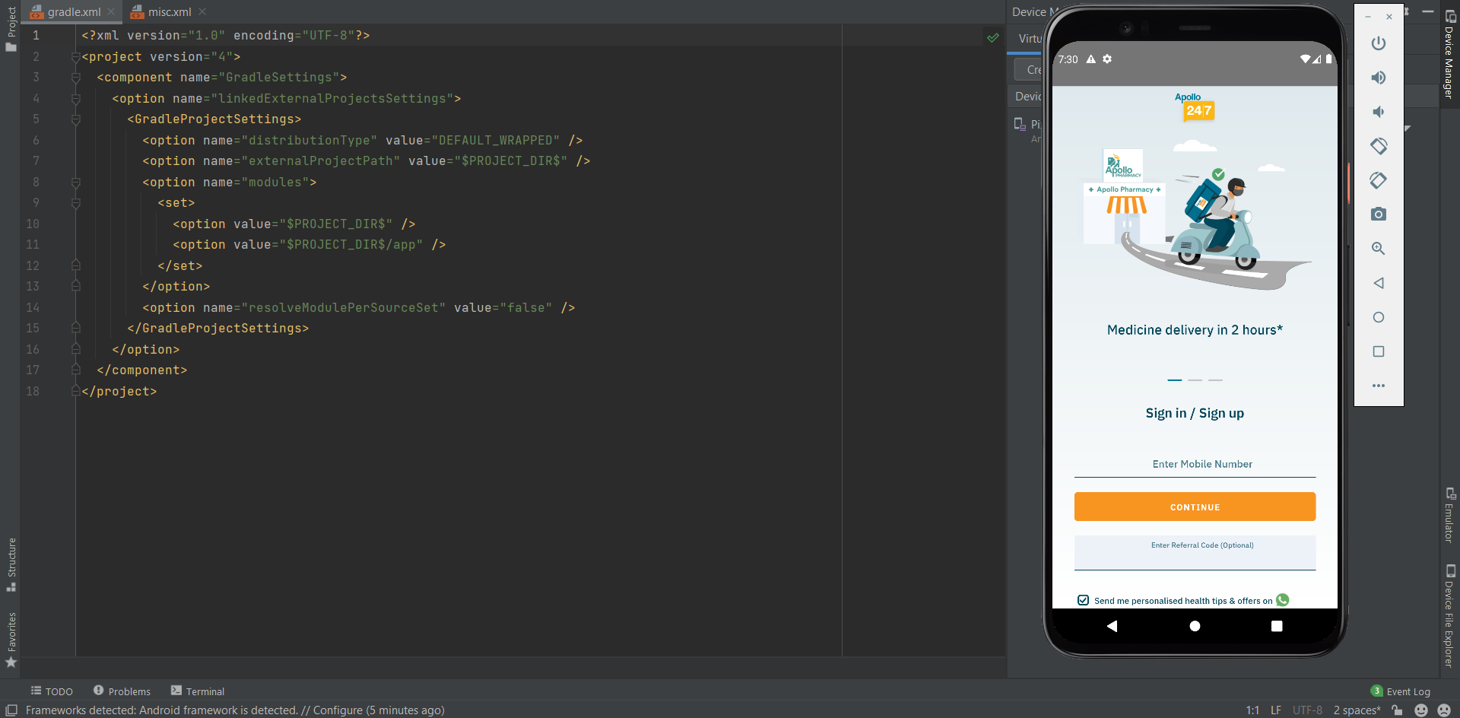
IMPLEMENTATION

Slide 11
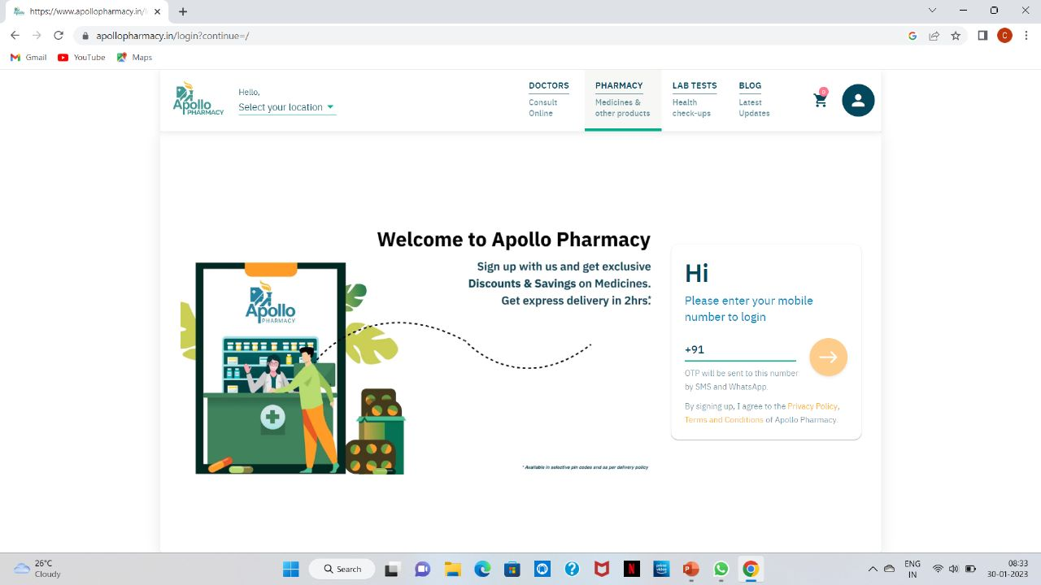
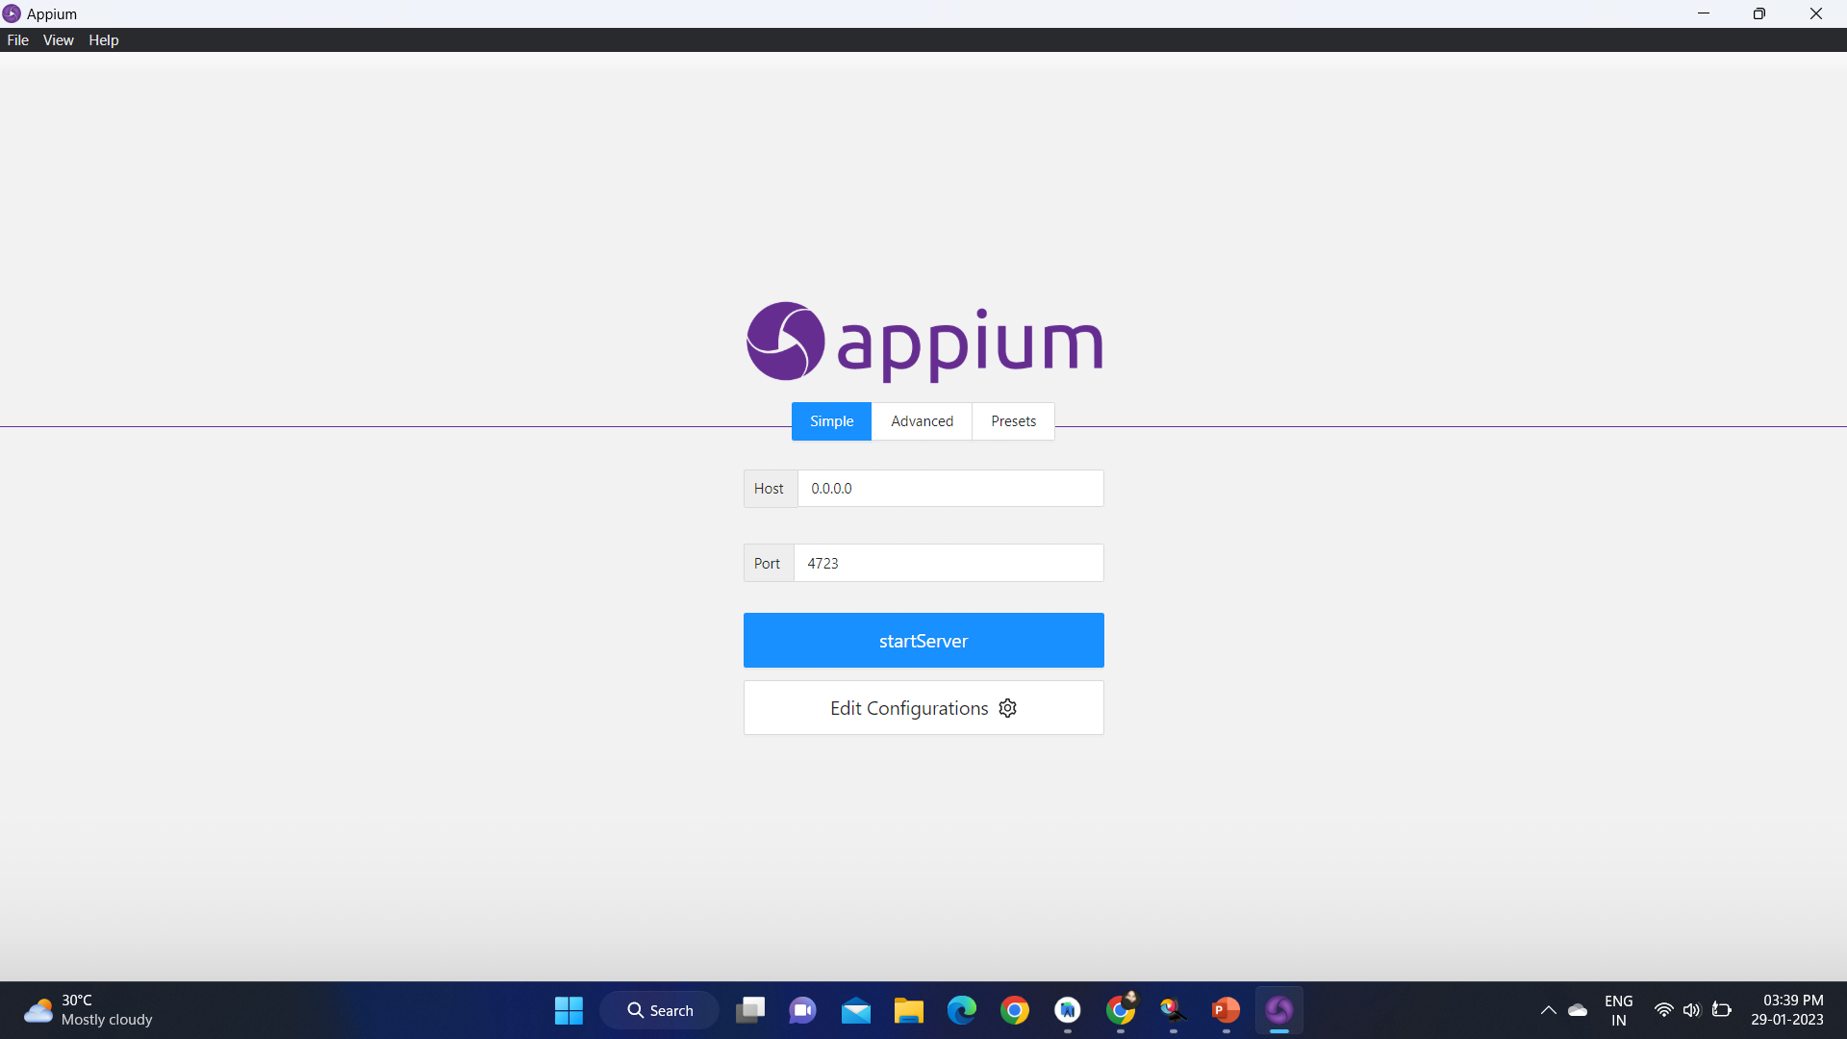

Slide 12
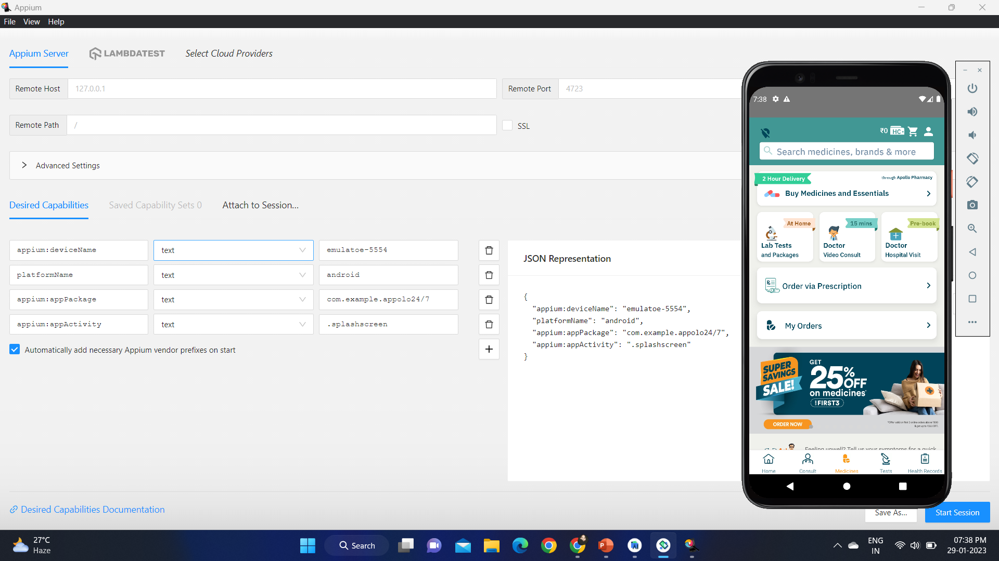
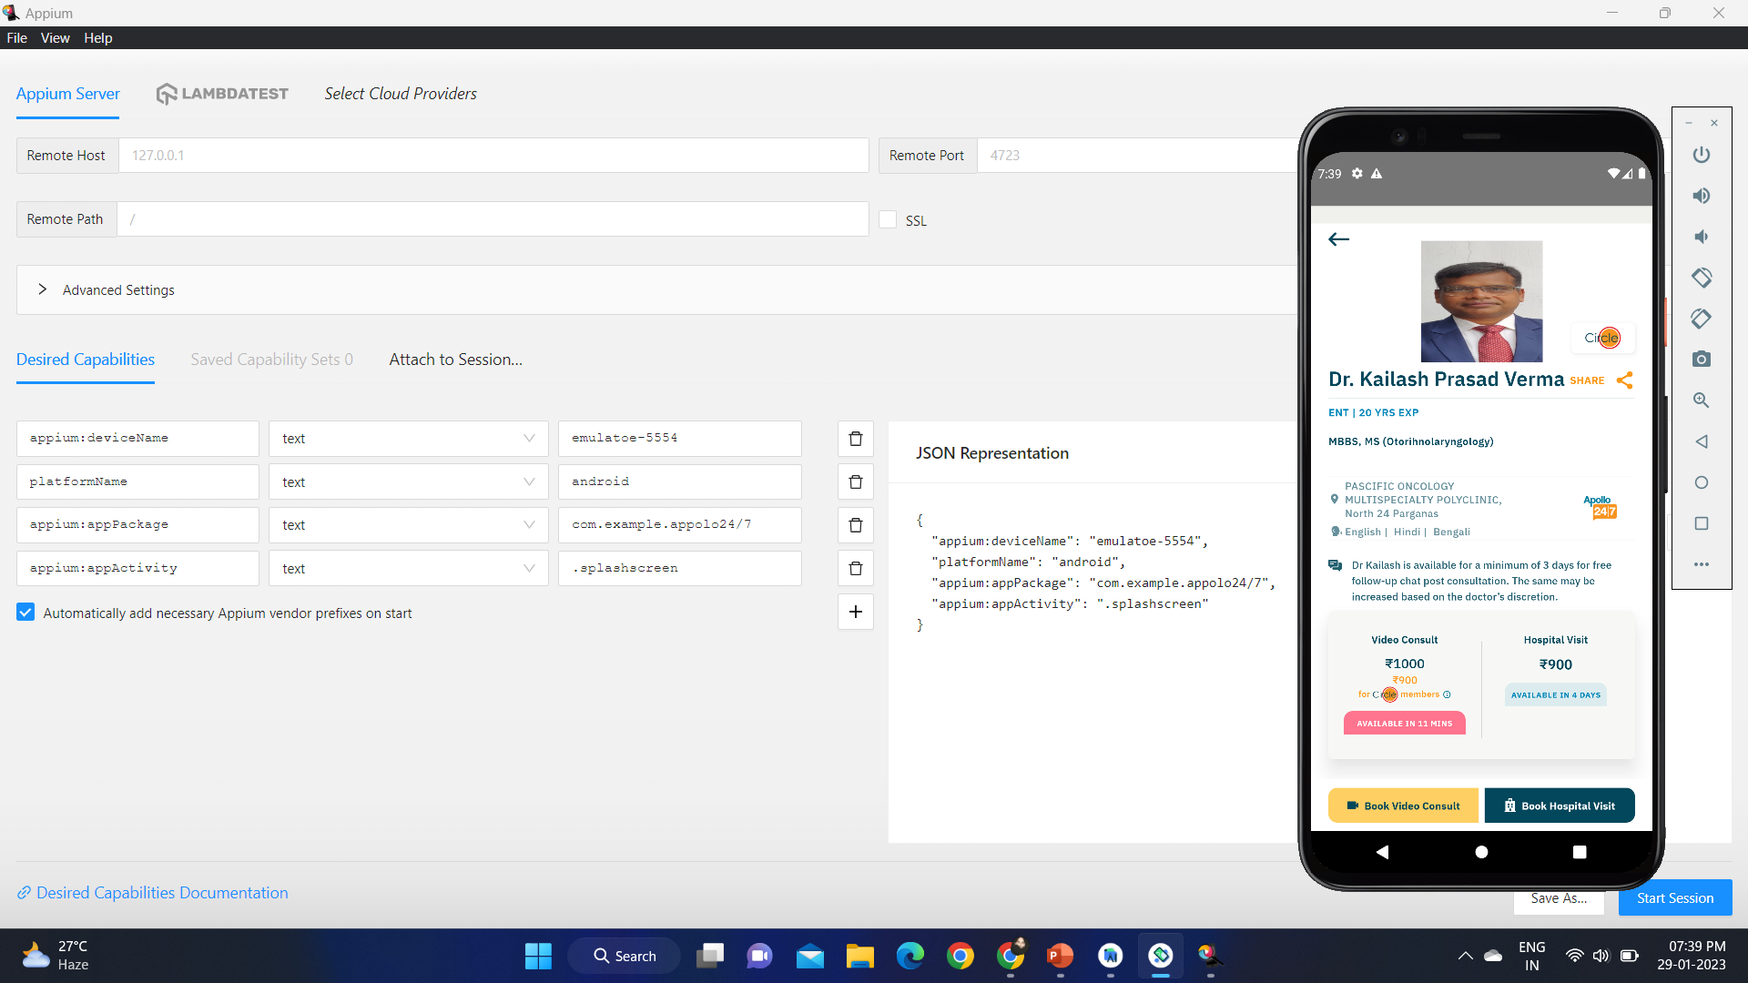

Slide 13
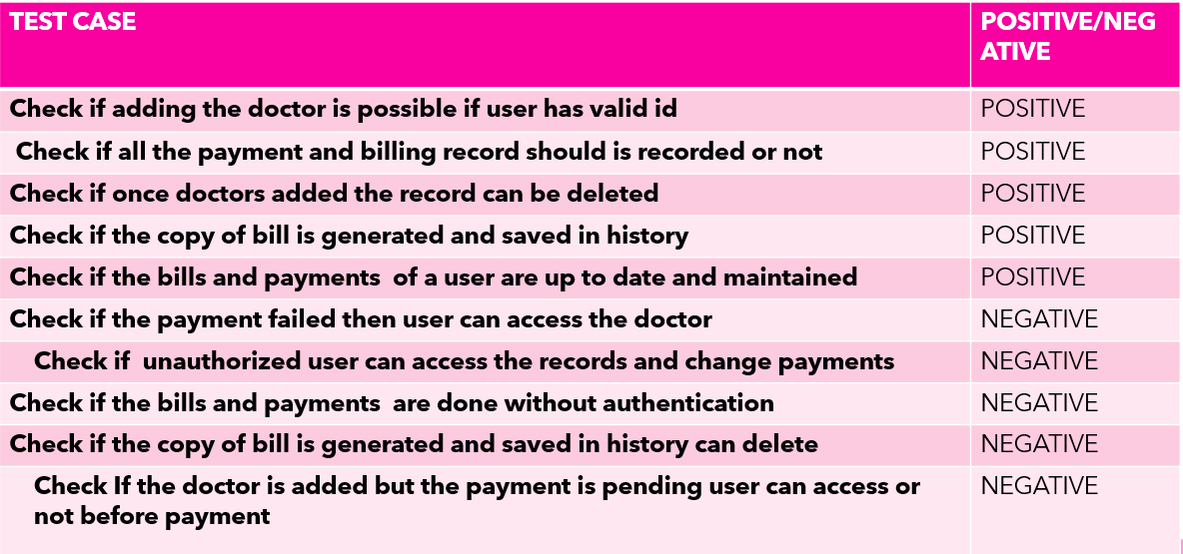
TESTCASE OUTCOMES

Slide 14
CONCLUSION
We finally navigated the apollo web application and find out the positive and negative i.e pass/fail test cases. This is to improve the applications performance in better manner and works best.

